Slide 1

SMART ALGO TRADING
A NEW ERA

Slide 2



PG-DIPLOMA IN ARTIFICIAL INTELLIGENCE
TOPIC:- SMART ALGO TRADING
(A New Era Of Trading In Financial Markets)
Presented By :- Sanket V. Patil
Nagarjun D. Honrao
Prasad S. Koparde

Slide 3

INTRODUCTION
In the last couple of years, stock market has become the latest fad in investment and money management.
The trade can generate revenue at enhanced speed and frequency.
Currently, there are hundreds of different stocks that are available to trade. This leads to a lot of volatility, which means that money can be made and lost easily.
Smart Algo Trading Bot (SAT BOT) will automatically trade user strategies on different market conditions in day-to-day trading.

Slide 4
PURPOSE AND NEED
Algorithmic trading is now more important for surviving in
future financial markets.
Industry reports suggest global algorithmic trading
market size is expected to grow from $11.1 billion in 2019
to $18.8 billion by 2024. So, the future of Algorithmic
trading is yet to come.
A simple and efficient bot to use in various market
situations by a common man has driven the need of this
project.
The main purpose to make a revolution in future
trading world.

Slide 5
PROBLEM STATEMENT AND SOLUTION
Human emotion is usually one of the biggest barriers to a successful trading strategy. The market is sometimes
irrational and doesn’t follow expected paths. It is usually our greed that takes over and causes us to lose money and not
take profits when they should have taken.
It is to build an Trading Bot which will work on Manually tested Strategy i.e. RSI(Relative Strength Index) and EMA(Exponential Moving Average) for Intraday and Option Trading.
In Whole Trading session continuous modifications to ensure the best trades and reducing over trading to avoid large Transaction charges and enabling huge profits rather than loses for the user/common man.

Slide 6
WORKING METHODOLOGY
Importing required libraries like selenium webdriver, nsepy etc.
Building the logic for the trade.
Analyzing the market.
Taking trade according to the strategy.
Waiting for Final P&L (profit and loss) statement.

Slide 7


STRATEGY USED
The combination of the RSI (Relative Strength Index) and EMA (Exponential Moving Average) indicators are used.
when RSI>=30 and RSI<=70 & EMA== “BUY” that means if a 5 min Candle is close above 10 days ema then we can buy 1 stock of particular company and it will take profit & loss according to what R:R (Risk To Reward) ratio is given to BOT.
when RSI>=50 & EMA== “SELL” that means if a 5 min Candle is close below 10 days ema then we can sell 1 stock of particular company and it will take P&L according to what R:R ratio is given to BOT.

Slide 8

In Our project the BOT will take profit of 10 points and loss of 5 points that will make R:R ratio to 1:2 and i.e. considered as suitable ratio in market.
In general, One can use the risk and reward according to their capital deployed to trade in the market.
This strategy is manually tested and it has given approx. 80% return.

Slide 9
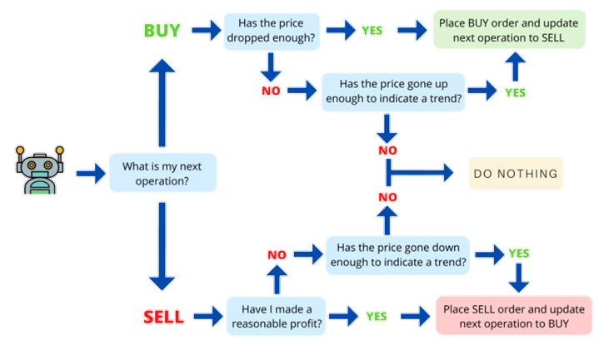
FLOW-CHART
BOT

Slide 10
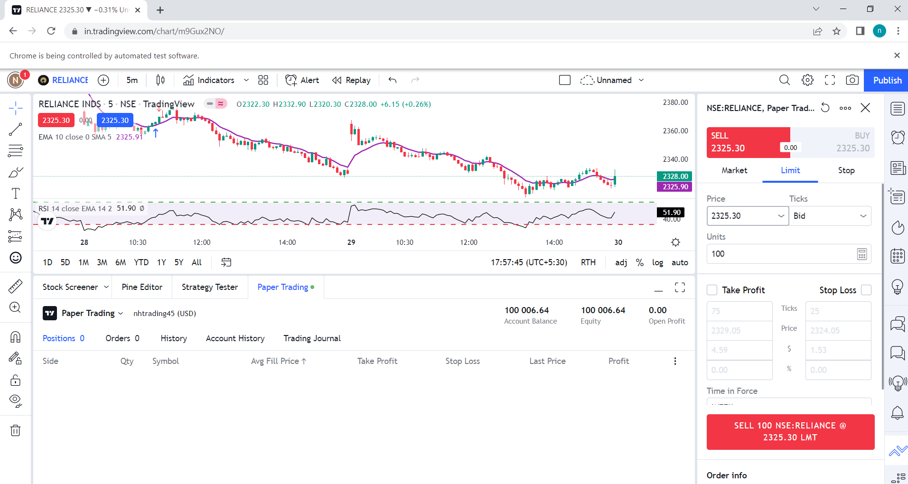
VISUALISATION AND RESULTS
When the code is executed the bot starts
fetching this API i.e TradingView Api.

Slide 11
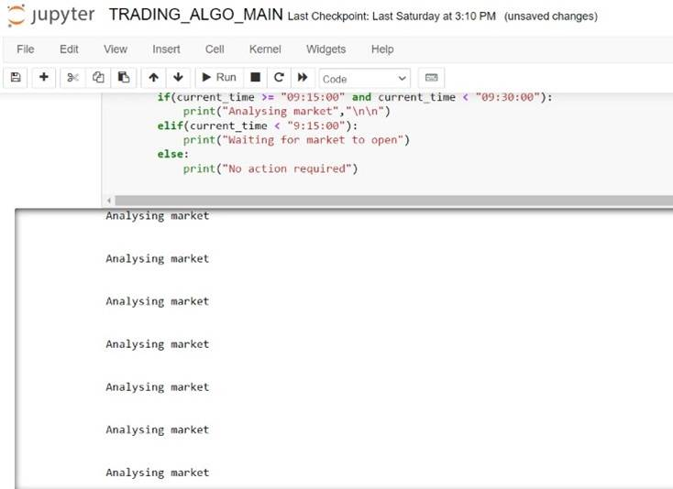
Afterwards, the bot will start analyzing the market.

Slide 12
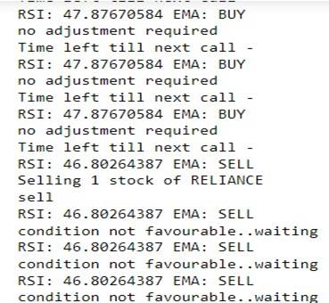
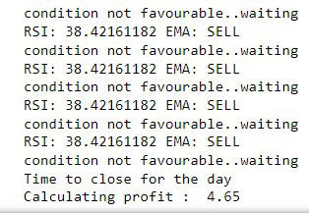
When the strategy meets the requirements,
the Bot then starts Buying and Selling the
stocks.
A single day Profit
(Intraday)

Slide 13
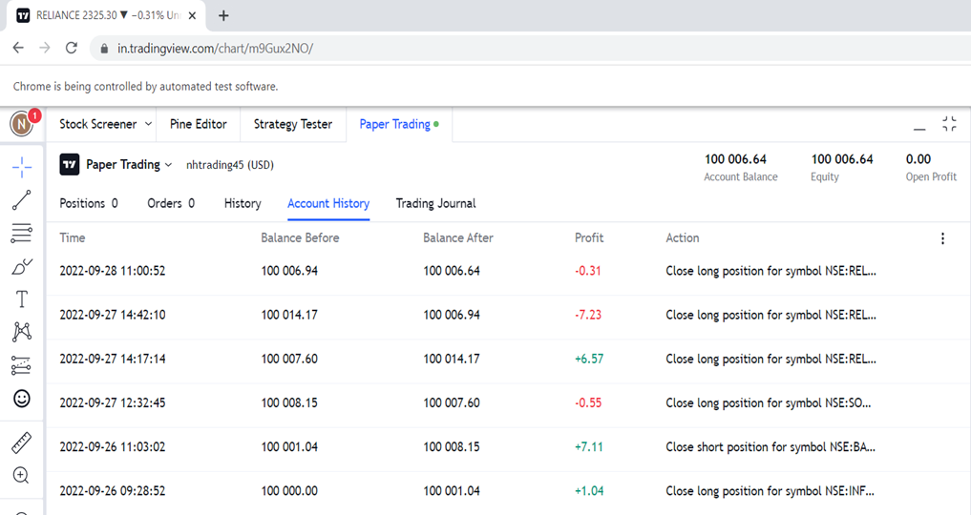
Final Results for various stocks in a single day.

Slide 14
FUTURE SCOPE
We have planned to improvise the bot by adding some
extra features such as Making it more efficient for
every individual for use.
For now our Bot is only capable of handling a single stock in stock market and We would try to achieve more stocks for bot to access and trade at once in a single day.
We are also planning to shift in futures and options.
We want to remove indicator dependency.

Slide 15



